Slide 1
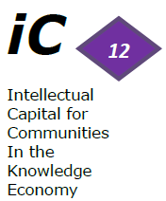



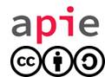
Data, Digital assets and
Platforms for innovation
The World Conference on Intellectual Capital for Communities
UNESCO, July 12&13
Session 8 : INTANGIBLES OF NATIONS , COMMUNITIES AND TERRITORIES
Public sector intangibles and the territorial growth - APIE
Text of the presentation under CC-BY-SA

Slide 2

Agency for public intangibles of France
Who are we ?
  Agency depending from the ministry of economy, finances and foreign trade
  Created in 2007 to value public intangible assets
  Mainly composed of
    Legal experts, specialized in IP right
    Marketing and innovation experts
Our mission :
  Contribute to the modernisation of the administration
  Unlock the potential of public intangible assets for the State economy as a whole
Innovation
IP right
Public Intangibles
Trade marks
Know-How
…
Digital content
Researchers
Private sector
Citizens / Communities

Slide 3
Agency for public intangibles of France
Research field : Measuring the impact of public intangibles on a region
  Public entities acting at local level manage numerous intangible assets
    Databases
    Cultural heritage assets
    Know-how
    Public investments in education, health
    Networks
    Etc. …
  These intangibles can generally be shared with third parties without loss to the public sector, thereby increasing the attractiveness of the region
  In turn, private sector activity affects the image and social and economic development of a region
  How to measure the value created out of this interaction between public and private intangibles ?

Slide 4

Agency for public intangibles of France
Example : “smart base” - Evreux*
  Project : open up the potential in terms of innovation of an military airbase by :
    Hosting start-ups in a digital incubator
    Facilitating partnerships between small players and the air force to design innovative solutions in field of digitization creating a “win-win” situation
    Sharing of knowledge and expertise of public agents (2.500 aviators working on the base) with start-ups
    Giving the possibility to create a proof of concept : testing in “real life” innovative solutions
  In turn, the French Air Force benefits from innovations created by third parties, accelerating their digital transformation
  *http://www.defense.gouv.fr/actualites/la-reforme/lancement-de-la-premiere-smart-base-a-evreux

Slide 5


Agency for public intangibles of France
Example : Louvre Lens Valley – cultural digital pole
  Project : bringing local actors together around digital projects in the cultural field :
    Actors concerned : companies/start-ups, non profit organizations, public actors (local authorities, museum, university)
    Catalyst : the presence of “Louvre Lens” and the force of its trademark
    Possibility to test innovations in a real life conditions (Louvre Lens museum) to create the proof of concept and benefiting from public expertise
    Reference for start-ups
  The legitimacy of the trademark “Louvre” has the power to federate different actors around one project and to provide an identity to communities

Slide 6

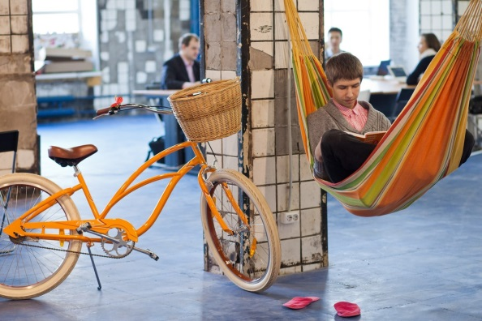

Agency for public intangibles of France
New community spaces for Innovation in territories
  Porosity : Fablabs & Makerspaces
  Conviviality : Third Places / Tiers-Lieux / co-Working
  Creativity : Art & Design inspired workshops

Slide 7
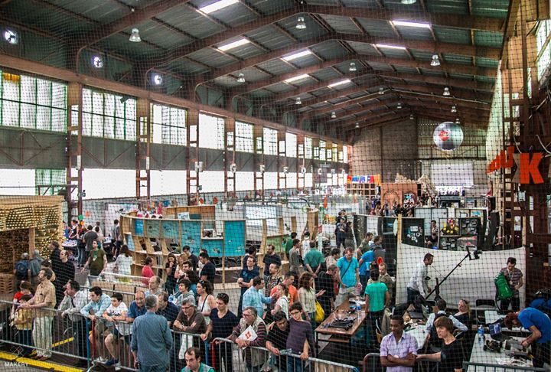
Agency for public intangibles of France
Porosity: ARTILECT Fablab Toulouse
Territorial asset: community building

Slide 8
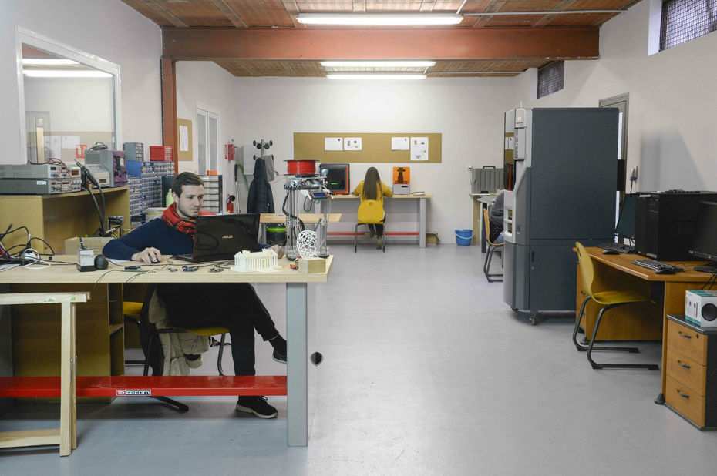
Agency for public intangibles of France
Porosity: ARTILECT Fablab Toulouse

Slide 9
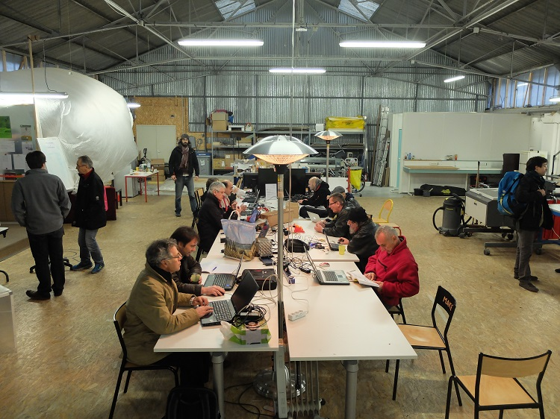
Agency for public intangibles of France
Conviviality: Plateforme C Fablab in Nantes
Territorial asset: Documentation and knowledge transmission

Slide 10
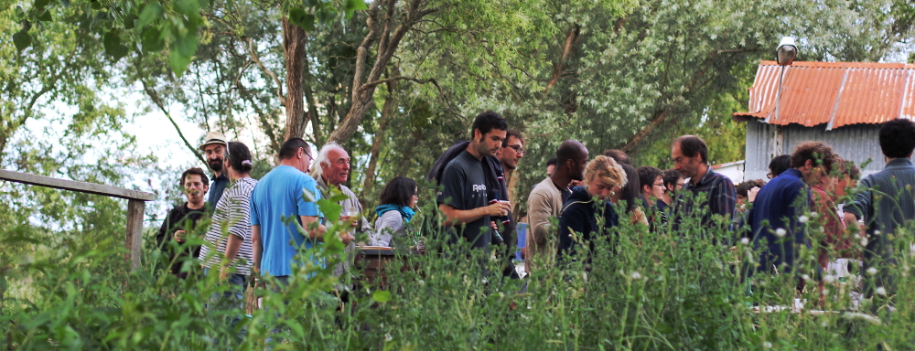
Agency for public intangibles of France
Conviviality: Plateforme C Fablab in Nantes

Slide 11
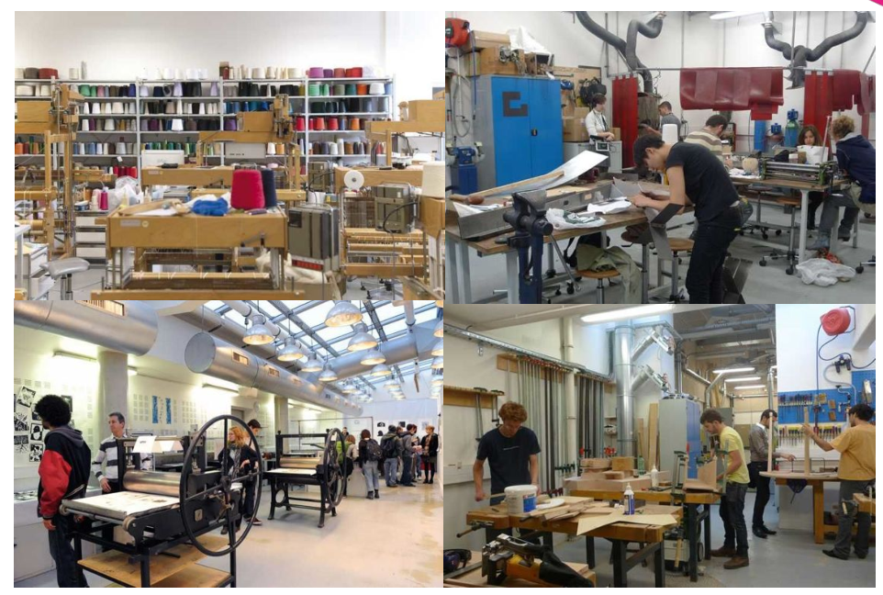
Agency for public intangibles of France
Creativity: Mobile Fablab Ecole des Arts Décoratifs in Paris

Slide 12
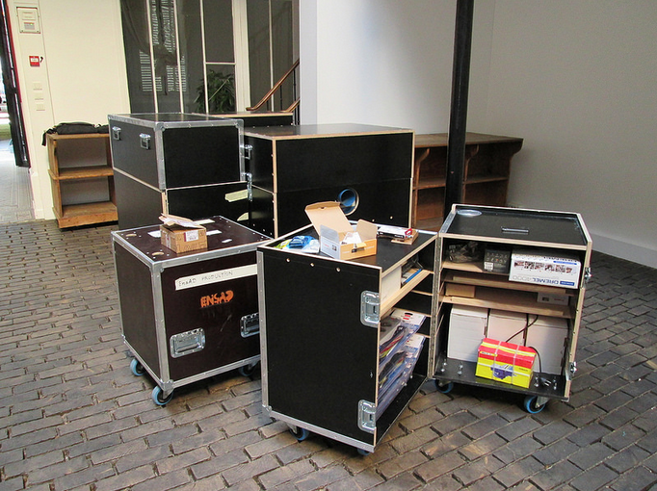
Agency for public intangibles of France
Creativity: Mobile Fablab Ecole des Arts Décoratifs in Paris
Knowledge asset : transborder territoires connection

Slide 13
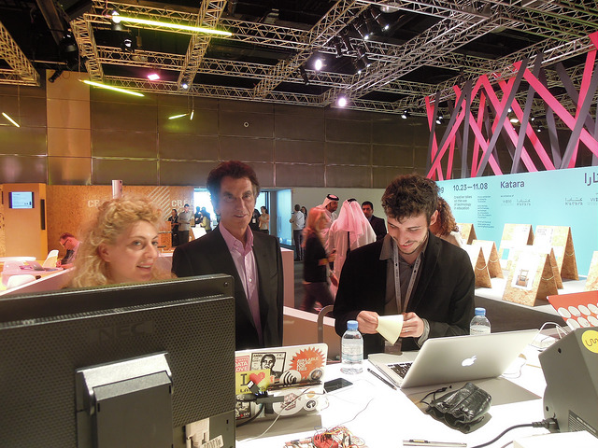
Agency for public intangibles of France
Creativity: Mobile Fablab Ecole des Arts Décoratifs in Paris

Slide 14
Agency for public intangibles of France
Thank you for your attention
Questions?
Web site : www.economie.gouv.fr/apie
Twitter : @APIE_gouv

